Slide 1

osint (open source intelligence) & Passive reconnaissance
Aqeeb Hussain (Durham DiRAC)
Offensive Security Tactics for Linux Professionals

Slide 2

Agenda
Topic one: Email/Domain Harvesting with theHarvester
Topic two: OSINT/Breached Credentials
Topic three: Google Dorking with GHDB (Google Hacking Database)
Topic four: BGP ASN/Host Enumeration with Netcraft
Topic Five: The Wayback Machine

Slide 3
Topic one
Email/Domain Harvesting

Slide 4
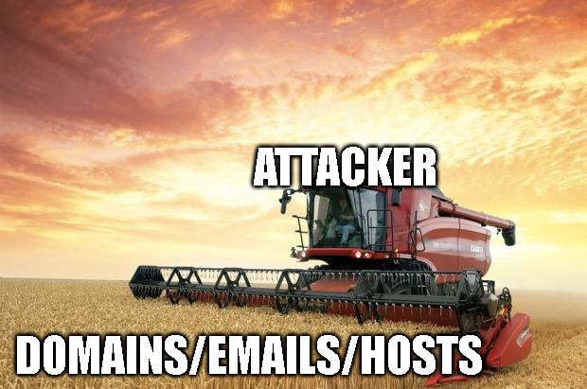
theHarvester
Written in Python, a scraping tool capable of querying the internet with multiple search engines.
Capable of gathering target domains, employee emails and target hosts
Supports passive reconnaissance (No direct communication to the target)
Notes:
TheHarvester, a tool which is written in Python is capable of scraping the internet and querying various search engines such as Google, Bing and Yahoo in relation to a provided target domain. You can also include LinkedIn profiles from theHarvester proving that theHarvester as an automation tool when conducting OSINT can be extremely powerful as we can use this information to determine any key employees who could be targeted in any phishing campaigns.
theHarvester is also extremely customisable. With the ability to plug this tool into many other APIs, we can extend its functionalities and we can try gaining more information on a target which would be helpful to us in the external testing phase.
TheHarvester is also capable for locating email addresses which are associated to the target domain, all of this information can come useful when querying breached credential APIs. Since we can grab any breached credentials to attempt gaining access to target infrastructure via legacy pathways such as IMAP to bypass 2FA (If IMAP is available). TheHarvester can also be very useful in mapping the target organisations domains together, we are able to see all of the different internet facing hosts which belong to the organisation which we can attempt to query for further information later on.
The best part of this as an attacker? You’re not making any interactions with the target organisation, you’re just querying the internet and information gathering. This is exactly the power of OSINT and is just the tip of the iceberg. OSINT can be used for many more operations such as finding misconfigured webpages against organisations, SSH keys if they’re on the internet, misconfigured management devices such as IDRACs which may be available through the internet, an easy way into the management network achieved by client side attack or infiltration. Some of these things will be demonstrated in these slides to prove the power of OSINT and why a trained adversary chooses OSINT before making any further advances towards the target.
theHarvester also has a sibling tool which achieves the same tasks but within a graphical environment known as Maltego. This tool is not covered in this course, but I’d encourage to explore other tools to find common trends/methods in which information is found to be able to conduct deeper OSINT. Tools in any situation can only provide information in some cases a limited amount, it is our job as adversaries to interpret this information correctly to aid our attempts to compromise the network.

Slide 5

What is OSINT?
A methodology involving the use of public data/OSINT tools to gather information against a target.
OSINT can target people/organizations
OSINT is the first step an adversary would take in order to gather information against a target.
OSINT is a completely passive process (No direct interaction or link to the target)

Slide 6
OSINT Tools
theHarvester
Netcraft
The Wayback Machine
Google Dorks
BreachDirectory API (Rohan Patra)
Notes:
Some of the tools I’ll be talking about which are used for OSINT. Firstly, social media. Social media is a great resource when conducting OSINT especially against people. This resource can be used for giving away personal information such as date of births, family member’s names, important locations, interests/hobbies. Social media can be used against an organisation too in which we can start to gather a profile of staff members who may work for the organisation who can be targeted in further attempts of compromise which may involve a phishing email or gaining breached credentials to attempt password spraying against known employee accounts to gain access into the infrastructure.
The next tool which is a lot more useful when targeting an organisation is theHarvester. TheHarvester, a tool which is written in Python is capable of scraping the internet and querying various search engines such as Google, Bing and Yahoo in relation to a provided target domain. TheHarvester is also capable for locating email addresses which are associated to the target domain, all of this information can come useful when querying breached credential databases and attempting to gain access to target infrastructure via legacy pathways such as IMAP. TheHarvester can also be very useful in mapping the target organisations domains together, we are able to see all of the different internet facing hosts which belong to the organisation which we can attempt to query for further information later on.
The next

Slide 7
Chart

Slide 8
Table
 | Category 1 | Category 2 | Category 3 | Category 4
Item 1 | 4.5 | 2.3 | 1.7 | 5
Item 2 | 3.2 | 5.1 | 4.4 | 3
Item 3 | 2.1 | 1.7 | 2.5 | 2.8
Item 4 | 4.5 | 2.2 | 1.7 | 7

Slide 9

The way to get started is to quit talking and begin doing.
Walt Disney

Slide 10
Team
Name Title
Name Title
Name Title
Name Title

Slide 11
Timeline
Title
To start a presentation, go to the Slide Show tab, and select From Beginning.
Title
To display Presenter view, in Slide Show view, on the control bar at the bottom left select the three dots, and then Show Presenter View.
Title
During your presentation, the speaker notes are visible on your monitor, but aren't visible to the audience.
Title
The Notes pane is a box that appears below each slide. Tap it to add notes.
Title
If you don’t see the Notes pane or it is completely minimized, click Notes on the task bar across the bottom of the PowerPoint window.

Slide 12
Title
Subtitle
Subtitle
Add text, images, art, and videos.
Add transitions, animations, and motion.
Save to OneDrive, to get to your presentations from your computer, tablet, or phone.
Open the Design Ideas pane for instant slide makeovers.
When we have design ideas, we’ll show them to you right there.

Slide 13
Title
Subtitle
Subtitle
Subtitle
Add text, images, art, and videos.
Add transitions, animations, and motion.
Save to OneDrive, to get to your presentations from your computer, tablet, or phone.
Open the Design Ideas pane for instant slide makeovers.
When we have design ideas, we’ll show them to you right there.
This PowerPoint theme uses its own unique set of colors, fonts, and effects to create the overall look and feel of these slides.
PowerPoint has tons of themes to give your presentation just the right personality.

Slide 14



Summary
With PowerPoint, you can create presentations and share your work with others, wherever they are. Type the text you want here to get started. You can also add images, art, and videos on this template. Save to OneDrive and access your presentations from your computer, tablet, or phone.

Slide 15




Thank you
Presenter name
Email address
Website

